Slide 1
The BIRTH of the Internet
Before the World Wide Web
Notes:
Twenty years ago, a networking class would have to cover a variety of technologies. Today, we only have to cover one: TCP/IP, the foundational protocol of the Internet.

Slide 2
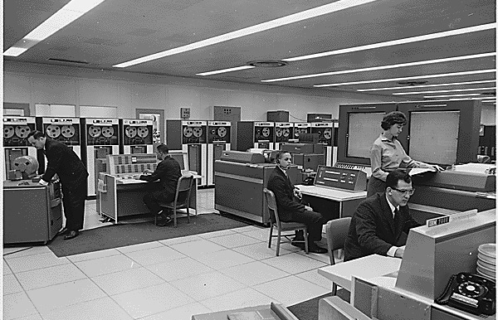
1960: Stand-Alone Systems
IBM 7090 computers used on NASA’s Project Mercury (1962)
Notes:
How many computers are in this room? Two. Each tape cabinet holds 3 megabytes. The RAM is over on the right side of the picture and holds 32K. The desks are for watching the processor—the binary state of each CPU register is shown in lights. Input is done with punch cards—that’s what the guy on the left is doing—and output goes onto printers like the one the woman is standing next to.
These computers were already outdated by the time this picture was taken in ’62… which is pretty much par for the course in government contracting.

Slide 3
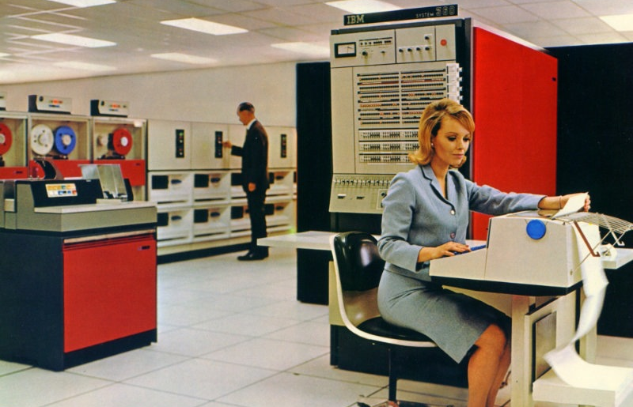
1965: Terminals and Time-Sharing
IBM System/360 Model 65 (1965)
Notes:
[AFTER THIS WHITEBOARD ABOUT SERIAL SIGNALLING]
You can see right away that by ’65, the world was now in color, so that was exciting. The important difference here is that typewriter-printer combo—that’s a terminal. Computers were now powerful enough that you could interact with them directly. In fact, they were powerful enough now that having just one person use the computer at a time was wasteful; you could connect multiple terminals like this one, and the computer would split its time handling one to the next.
These terminals connect to the computer using a direct wire connection, same as the tape drives and memory—same as your monitor cable. (Not the same as your keyboard cable; that’s actually a packet-switched connection.) You could be as far away from the computer as the wire… which could include the continuous circuit of a telephone connection.
Later terminals had screens instead of printers, but the idea was the same. In fact, the character set and protocols those terminals used were the same ones for the teletypes—that’s why ASCII contains characters for backspace, carriage return, line feed and bell.

Slide 4
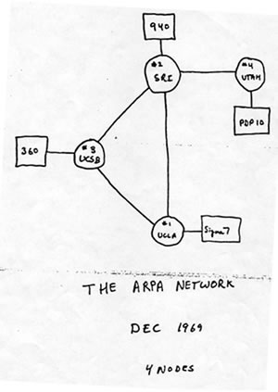
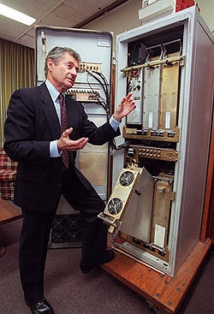
1970: The Arpanet is Born
First ARPA Network map (Larry Roberts, ARPAnet Program Manager, 1969)
Notes:
[AFTER THIS WHITEBOARD ABOUT MULTIPLEX SIGNALLING]
The US Department of Defense was a major investor in university computing through its Advanced Research Projects Agency. Its researchers needed a better way to communicate between computers—a team at UCLA might need to access data on a tape drive at the University of Utah; a team at MIT might need time on a supercomputer at Stanford.
To solve this problem, ARPA contracted the development of the Arpanet. This consisted of special computers, called IMPs (Interface Message Processor), that communicated with each other over dedicated telephone circuits. Though the IMPs shared a common protocol with each other, each had to be programmed separately to talk to its local resources—the code to talk to an IBM System/360 was different from the code to talk to a PDP-10.
Those resources weren’t just computers, but also tape drives and printers, all connected using serial cables to the IMP. In general, computers didn’t really talk to each other at this stage of the Arpanet—terminals would talk to remote computers, and computers would talk to remote resources. For example, email (invented in 1972 by Ray Tomlinson) initially worked by writing files directly to the local storage of the server; there was no “email server” program.
ARPANET was a packet-switched connectionless network… just like the telegraph. So just like the telegraph, it had to deal with buffering (not ready for another packet yet) and lag (in fact, the very first document describing work on IMP communication talks about the half-second lag required to echo a typed character).
Also, it had to deal with routing. You can see in our diagram that UCSB, Stanford and UCLA could all talk to each other directly, but to send a packet to the University of Utah it had to go through SRI. We’ll come back to routing, because it’s what’s most interesting about ARPANET (and thus the Internet). You can look at this diagram and say, “oh, hey, routing is super-simple”, but in fact they invented a system for creating and maintaining network maps like this one that was vastly more sophisticated and powerful than technically required. It’s because they did that ARPANET was able to grow.

Slide 5
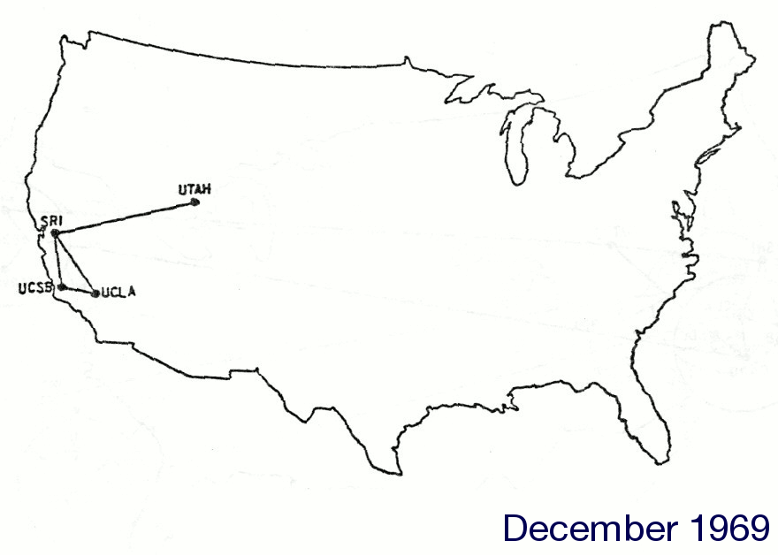

1970-1982: GROWTH AND REFINEMENT
ARPANET Network Maps, FROM THE COLLECTION OF J. Noel Chiappa (1969-1982)
Notes:
As ARPANET grew, its developers hit limitations fundamental to the system. Some of the key ones:
Because the hardware connected to an ARPANET IMP was largely ignorant of networking (it just thought the IMP was a slow terminal or tape drive), the IMPs couldn’t afford to ever lose a packet—the machines at the ends of the connection had no way of resending a packet. Some network “smarts” had to move to the local networks.
Because of that, the IMP couldn’t acknowledge a packet from a local machine until the far machine had ack’ed it. This slowed file transfers down a great deal. Moving network awareness to the hosts would let them have multiple packets en route.
They needed a better addressing scheme. The first ARPANET packet header only allowed 5 bits for IMP address.
ARPANET had some very limited error detection, but more was needed.
Notice how these problems are aspects of DUST—uncertainty, scale and time. (Danger wasn’t an issue yet because so few institutions were even allowed to be on ARPANET. But danger was on its way… [1988])
Robert Kahn (one of the developers of the IMP) was tasked to define the new protocol; he brought on board Vinton Cerf, who had been a graduate student at UCLA implementing the host connection for their IMP back in ’69.
source http://mercury.lcs.mit.edu/~jnc/tech/jpg/G82Feb.jpg

Slide 6
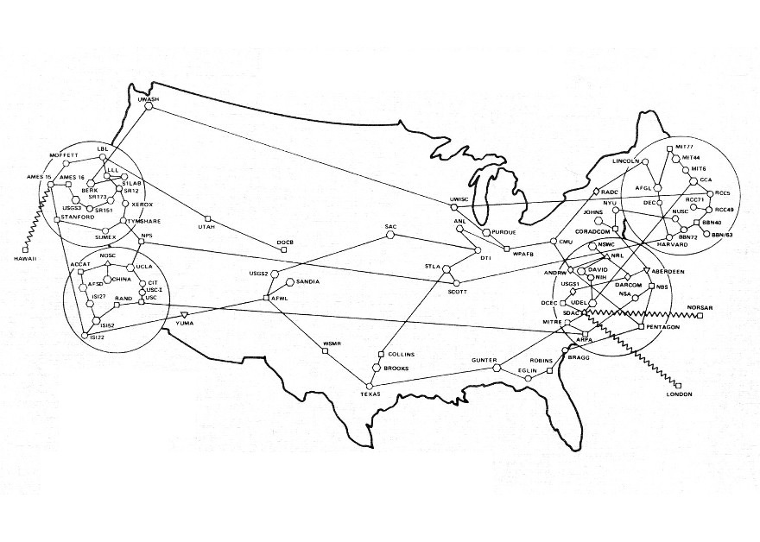
1970-1982: GROWTH AND REFINEMENT
ARPANET Network Maps, FROM THE COLLECTION OF J. Noel Chiappa (1969-1982)
Notes:
As ARPANET grew, its developers hit limitations fundamental to the system. Some of the key ones:
Because the hardware connected to an ARPANET IMP was largely ignorant of networking (it just thought the IMP was a slow terminal or tape drive), the IMPs couldn’t afford to ever lose a packet—the machines at the ends of the connection had no way of resending a packet. Some network “smarts” had to move to the local networks.
Because of that, the IMP couldn’t acknowledge a packet from a local machine until the far machine had ack’ed it. This slowed file transfers down a great deal. Moving network awareness to the hosts would let them have multiple packets en route.
They needed a better addressing scheme. The first ARPANET packet header only allowed 5 bits for IMP address.
ARPANET had some very limited error detection, but more was needed.
Notice how these problems are aspects of DUST—uncertainty, scale and time. (Danger wasn’t an issue yet because so few institutions were even allowed to be on ARPANET. But danger was on its way… [1988])
Robert Kahn (one of the developers of the IMP) was tasked to define the new protocol; he brought on board Vinton Cerf, who had been a graduate student at UCLA implementing the host connection for their IMP back in ’69.
source http://mercury.lcs.mit.edu/~jnc/tech/jpg/G82Feb.jpg

Slide 7
1970-1982: GROWTH AND REFINEMENT
Problems
No ability to retransmit packets lost by an IMP
Only one packet could be en route at a time
Limited address scheme.
Limited error detection
Demand for communication between networks
ARPANET Network Maps, FROM THE COLLECTION OF J. Noel Chiappa (1969-1982)
Notes:
As ARPANET grew, its developers hit limitations fundamental to the system. Some of the key ones:
Because the hardware connected to an ARPANET IMP was largely ignorant of networking (it just thought the IMP was a slow terminal or tape drive), the IMPs couldn’t afford to ever lose a packet—the machines at the ends of the connection had no way of resending a packet. Some network “smarts” had to move to the local networks.
Because of that, the IMP couldn’t acknowledge a packet from a local machine until the far machine had ack’ed it. This slowed file transfers down a great deal. Moving network awareness to the hosts would let them have multiple packets en route.
They needed a better addressing scheme. The first ARPANET packet header only allowed 5 bits for IMP address.
ARPANET had some very limited error detection, but more was needed.
Notice how these problems are aspects of DUST—uncertainty, scale and time. (Danger wasn’t an issue yet because so few institutions were even allowed to be on ARPANET. But danger was on its way… [1988])
Robert Kahn (one of the developers of the IMP) was tasked to define the new protocol; he brought on board Vinton Cerf, who had been a graduate student at UCLA implementing the host connection for their IMP back in ’69.
source http://mercury.lcs.mit.edu/~jnc/tech/jpg/G82Feb.jpg

Slide 8

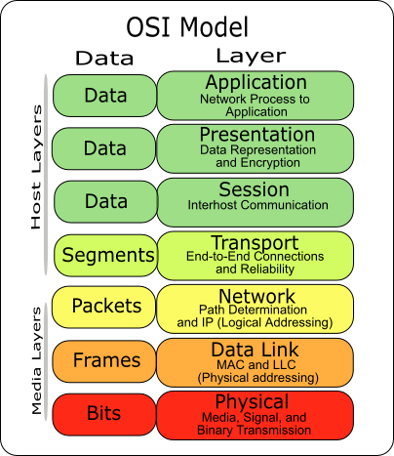
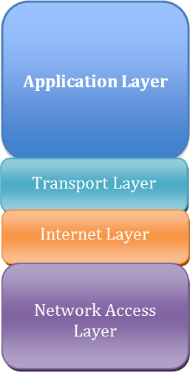
OSI MODEL
Notes:
This is the OSI model. A lot of people consider this to be a useful and informative way of looking at the levels of abstraction involved in networking…
[CLICK]
but it’s not. I was thinking about devoting a 20-minute block to this, but then I realized that I’d hate it, and if I hate it you’ll probably hate it, so screw that.
So here’s what you need to know about the OSI model: The higher you go up the chart, the more abstract things are. The bottom is the actual way bits go over the wire, the top is, well, what it says on the tin, your application.
Here’s the other thing you need to know: ALL PEOPLE SEEM TO NEED DATA PROCESSING. This mnemonic will help you remember the layers of this model, which I promise you someone will ask you about in an interview one of these days.
So let’s see the model you should use instead. [By the way, if you want to google for more information on this, be sure to call it the TCP/IP Model. Another name for it is the Internet Model, but if you search for “internet model” you get a COMPLETELY DIFFERENT set of results.]
The Internet model has four layers, which is good because there’s only four layers of abstraction in practice. [CLICK] There’s your application, the transport layer—that’s UDP and TCP—the Internet layer, and the network itself—Ethernet.
[CLICK]
Each of these manifests itself by adding data to the datagram. So you create data, you wrap it in UDP, the operating system wraps that in IP, and the network driver wraps that in a frame. The set of software responsible for making all this happen is called a “TCP stack”, because it behaves like a stack.
Oh, and you want a mnemonic to remember this one? ALL THAT IS NECESSARY.

Slide 9
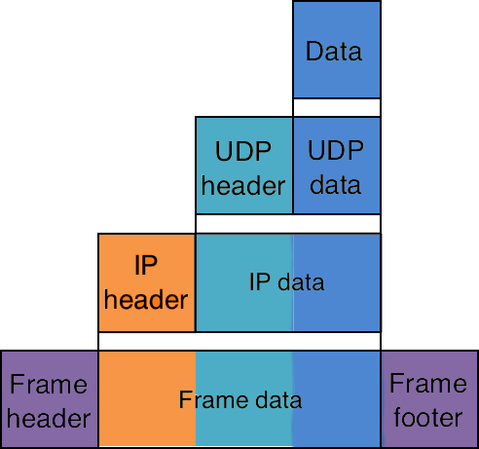
INTERNET MODEL

Slide 10
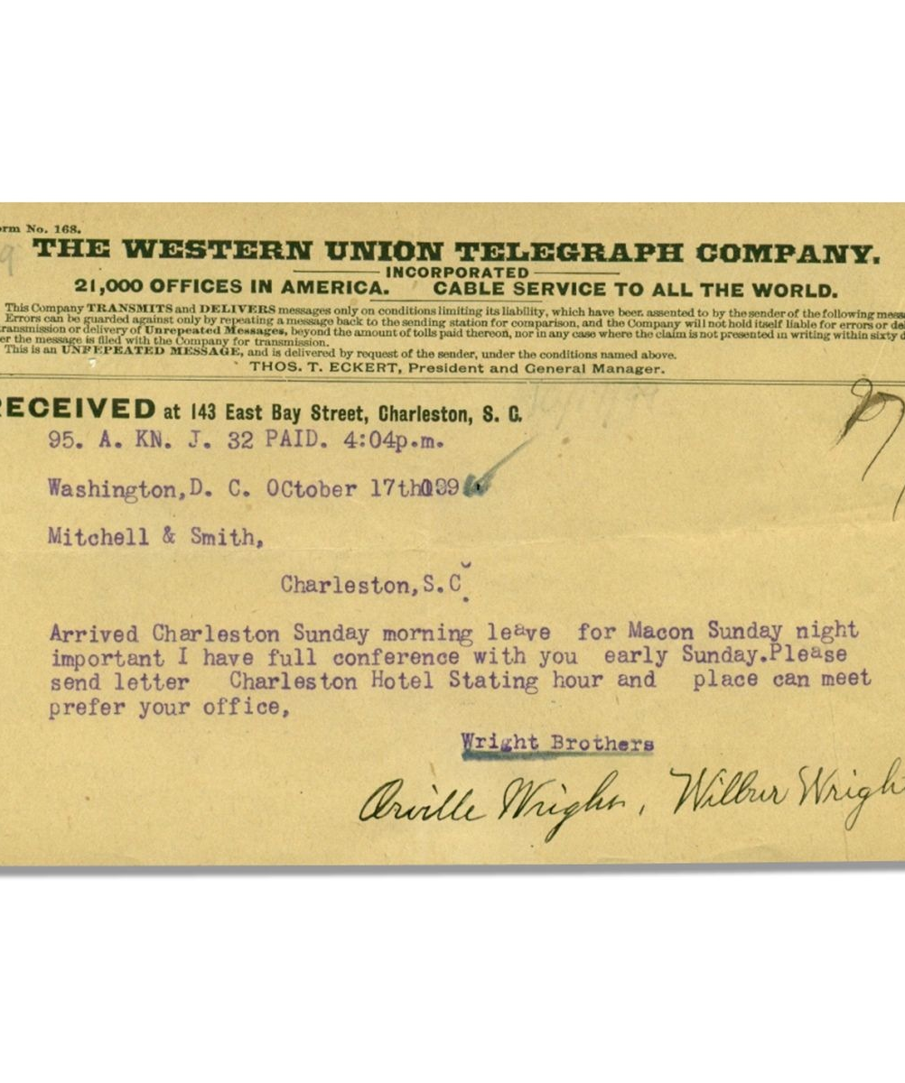
Telegrams
Self-contained
Conveys data
Independent
Ignorant of its medium
Notes:
So here’s a telegram, from 1899. What’s true about it?
Well, it’s self-contained—everything we need to deliver it is right here. Network address, local address, source, message, even whether it was paid for.[CLICK]
It carries data. In fact it doesn’t matter what data it carries—the telegram gets delivered regardless.[CLICK]
It’s independent of other telegrams—maybe it refers to them, but that’s up to the writer, and just matters for content. The telegram itself gets delivered without that information.[CLICK]
And it’s ignorant of its medium. It doesn’t matter how this message gets sent. It’s not, for example, pre-translated into Morse code. It contains addressing information, but that info is opaque to the author. And there may be other data associated with it, but that all gets stripped away before delivery.

Slide 11
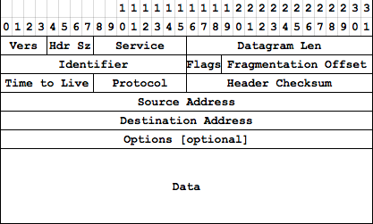
“A self-contained, independent entity of data carrying sufficient information to be routed from the source to the destination computer without reliance on earlier exchanges between this source and destination computer and the transporting network.”
—RFC1594
Notes:
Datagrams were modeled in part on telegrams—that’s where the name comes from—and their formal definition matches what we identified was true about telegrams.
Don’t pay attention to the diagram yet.
Datagrams are the fundamental unit of the Internet. FTD wants you to say it with flowers; well on the Internet you say it with datagrams. But datagrams are just like that telegram—they’re an abstraction. So let’s see what we’re abstracting away.

Slide 12
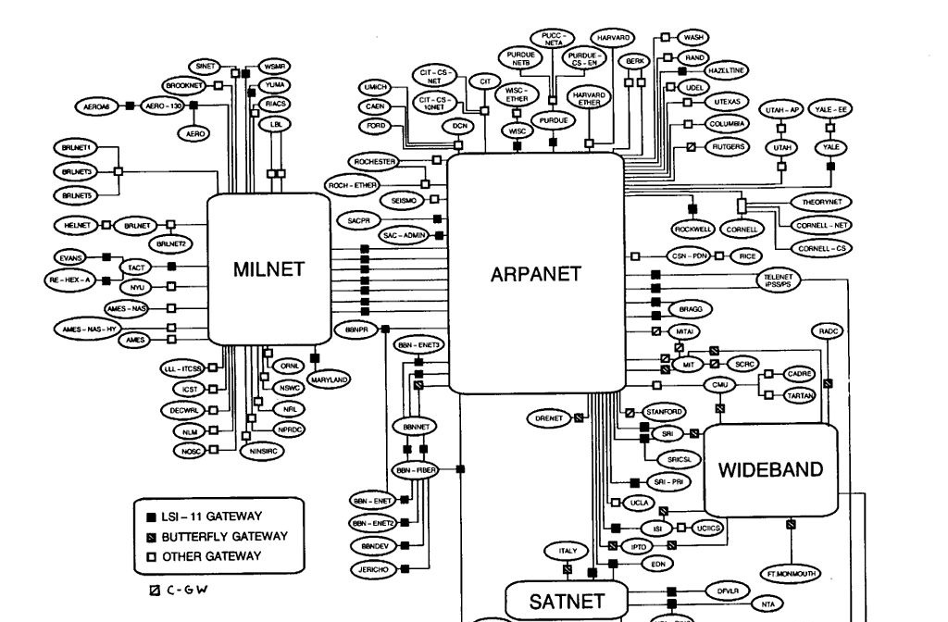
1983-1993: TCP/IP and the Internet
Map of the Internet (BBN Communications Corp., 1985)
Notes:
Kahn and Cerf’s work was formally adopted January 1, 1983. Now that the addressing scheme permitted it, ARPANET became just one network in a “network of networks”—the Internet. (If this same transition happened today, it’d probably be called the “Metanet” instead.) Each network could connect to others through gateways; since they all ran on TCP/IP, not only could the networks interoperate through those gateways, but they could actually forward other networks’ traffic.
Let’s finally talk about how that routing works.

Slide 13
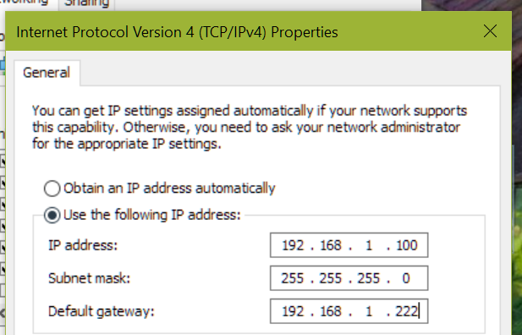
TCP/IP ADDRESSING
425-629-5076
425-629-5076
Area network
Local network
Node
IP Address Configuration Dialog (Windows NT 4.0, 1997)
Notes:
Okay, who’s seen a dialog like this one? Well congratulations, as of today you’ll be able to tell people what those boxes mean.
Let’s first think about an addressing scheme you’re more familiar with, phone numbers. My office number is 425-629-5076. The 425 says what phone network I’m on—the Eastside—the 629 specifies the subnetwork—Digipen—and the 5076 is my local address on that network. If I want to call Admissions, at 425-629-5001, I don’t have to step out to the external network, I just dial the local address, 5001. I know how the phone subnetwork is allocated, because it’s defined in the standard.
Every node on the Internet has a unique address. Originally, and generally still today, addresses were 32-bit values; there’s a push to move to IPv6, where addresses are 128 bits, but I don’t want to talk about that today. Like phone numbers, some portion of that 32 bits identifies the network, and the rest identifies a node within that network… but unlike phone numbers, the system can change from network to network.
This is identified by the subnet mask.

Slide 14
TCP/IP ADDRESSING
192.168.1.100
255.255.255.0
IP Address Configuration Dialog (Windows NT 4.0, 1997)
Notes:
Every node on the Internet has a unique address. Originally, and generally still today, addresses were 32-bit values; there’s a push to move to IPv6, where addresses are 128 bits, but I don’t want to talk about that today.
IPv4 addresses are by tradition written in “dotted-decimal” notation. This is pretty much the only place you’ll ever see this notation, and it looks weird. The big reason for this notation is literally that people back then just weren’t familiar or comfortable with hexadecimal—it’s not more complicated than that. This brings up an important point: A lot of stuff on the Internet is done a certain way simply because it’s “always” (“always” being “as much as TWENTY WHOLE YEARS AGO!”) been done that way, and was originally done that way for bad reasons that no longer apply. Don’t hesitate to question everything.
Anyway, in hex, this address would be C0A80A01, but you’ll never, ever see an IP address written that way. There’s something useful about IP addresses having a uniquely recognizable format, so it persists.
Like phone numbers, some portion of that 32 bits identifies the network, and the rest identifies a node within that network… but unlike phone numbers, the system can change from network to network. This is identified by the subnet mask. This will be easier to understand if we switch from dotted-decimal to binary…

Slide 15
TCP/IP ADDRESSING
11000000.10101000.00000001.01100100
11111111.11111111.11111111.00000000
11000000.10101000.00000000.________
01100100
IP Address Configuration Dialog (Windows NT 4.0, 1997)
Notes:
The 1s in the subnet mask identify the network; the 0s identify the node. To get the network, AND the IP address against the mask; to get the node, AND the IP address against the inverse of the mask. [You all know how to do binary arithmetic, yes? Good.]
Now, this example is trivial, because the subnet is just the bottommost 8 bits. In the first version of the TCP/IP scheme, there were only 256 networks, and the subnet was always the bottommost 24 bits. That proved unwieldy, so they moved to a scheme were there could be smaller networks, and networks within networks.
The “default gateway” down there is simply the IP address of the node that’s responsible for routing packets upward from our local subnet here. Which brings us to routing.

Slide 16



TCP/IP Routing
192.168.1.1
192.168.1.5
192.168.1.7
192.168.1.222
192.168.1.10
Local Area Network (LAN): “ping 192.168.1.7”
Notes:
Here we have a simple local network, four PCs and a router connected to one hub. The technology here is twisted-pair Ethernet. Every machine on the local network sees every packet, and just pays attention to the ones addressed to it.
Let’s say our machine, .10, wants to send a packet to .7. It knows from the net mask that .7 is on the same subnet, so it doesn’t have to talk to the router at all—it just sends the packet directly to .7. Technically, the packet gets repeated by the hub on all lines, and just ignored by the other machines, same way telegrams worked, but conceptually it’s sent “from” .10 “to” .7.

Slide 17
TCP/IP Routing
192.168.1.222
74.40.1.101
192.168.1.10
WIDE Area Network (WAN): “ping 68.142.77.176”
Notes:
Now we’re pinging something outside our network, which means we send the packet to the default gateway—our router. (In a home wifi setup, the hub and the router are the same piece of hardware, but they’re logically separate and in work environments usually physically separate.)
Our router knows nothing about the rest of the Internet—the Internet is, for all practical purposes, infinitely big. All our router knows is that it has its own default gateway, and in the absence of any other information, it just sends the packet along. Our router’s gateway is a router at our ISP.

Slide 18
TCP/IP Routing
74.40.5.126
68.142.92.253
74.40.1.101
68.142.92.249
WIDE Area Network (WAN): “ping 68.142.77.176”
Notes:
The ISP has a large network; we’re just going to look at part of it, and likewise part of our target’s network. There’s two routers at our ISP, connected to each other [CLICK]…
…two at the target network, also connected [CLICK]…
…a high-capacity connection between our ISP and theirs [CLICK]…
…and a low-capacity connection. [CLICK]
Each one of these routers maintains a routing table that tells it “traffic for network X should be sent to IP address Y”. Right now, all those routing tables are empty.

Slide 19

TCP/IP Routing
68.142.77.*=68.142.77.1 [1]
68.142.92.253
68.142.77.176
74.40.5.126
68.142.77.1
74.40.1.101
68.142.92.249
WIDE Area Network (WAN): “ping 68.142.77.176”
Notes:
The destination server is here, on subnet 68.142.77.*.
On a regular interval—or when requested to do so—each router tells its neighbors about the routes it knows. So, 68.142.77.1 says “Hey, I know how to reach 68.142.77.*—you talk to me, and the packet gets there in one hop.”

Slide 20
TCP/IP Routing
68.142.92.253
68.142.77.176
74.40.5.126
68.142.77.*=68.142.77.1 [2]
68.142.77.1
74.40.1.101
68.142.92.249
WIDE Area Network (WAN): “ping 68.142.77.176”
Notes:
68.142.92.249 says “well, that’s interesting, thanks for telling me.” Note that it increments the hop count to .77.

Slide 21
TCP/IP Routing
68.142.77.*=68.142.92.249 [2]
68.142.92.*=68.142.92.249 [1]
68.142.92.253
68.142.77.176
74.40.5.126
68.142.77.1
74.40.1.101
68.142.92.249
WIDE Area Network (WAN): “ping 68.142.77.176”
Notes:
A bit later, 68.142.92.249 does its own announcement, and talks about its own network (.92), plus the .77 network it just learned about. Note that it replaces 68.142.77.1’s address with its own—it’s saying “you wanna talk to .77, you gotta come through me first.”

Slide 22
TCP/IP Routing
68.142.92.253
68.142.77.176
74.40.5.126
68.142.77.*=68.142.92.249 [3]
68.142.92.*=68.142.92.249 [2]
68.142.77.1
74.40.1.101
68.142.92.249
WIDE Area Network (WAN): “ping 68.142.77.176”
Notes:
74.40.1.101 says “well thanks for telling me”.

Slide 23
TCP/IP Routing
68.142.77.*=68.142.92.249 [3]
68.142.92.*=68.142.92.253 [1]
68.142.92.253
68.142.77.176
74.40.5.126
68.142.77.1
74.40.1.101
68.142.92.249
WIDE Area Network (WAN): “ping 68.142.77.176”
Notes:
As does 68.142.92.253. But this router is also on the .92 network, and is just as capable of routing traffic to it as .249 is. So it doesn’t change its route for .92—it already has a one-hop route to that.

Slide 24
TCP/IP Routing
68.142.77.*=68.142.92.253 [3]
68.142.92.*=68.142.92.253 [1]
68.142.92.253
68.142.77.176
74.40.5.126
68.142.77.1
74.40.1.101
68.142.92.249
WIDE Area Network (WAN): “ping 68.142.77.176”
Notes:
68.142.92.253 makes its announcement.

Slide 25
TCP/IP Routing
68.142.77.*=68.142.92.253 [4]
68.142.92.*=68.142.92.253 [2]
68.142.92.253
68.142.77.176
74.40.5.126
68.142.77.1
74.40.1.101
68.142.92.249
WIDE Area Network (WAN): “ping 68.142.77.176”
Notes:
74.40.5.126 says “that’s interesting.”

Slide 26
TCP/IP Routing
68.142.77.*=74.40.5.126 [4]
68.142.92.*=74.40.5.126 [2]
68.142.92.253
68.142.77.176
74.40.5.126
68.142.77.1
74.40.1.101
68.142.92.249
WIDE Area Network (WAN): “ping 68.142.77.176”
Notes:
and makes its announcement. Now, just as an aside here, each router is smart enough not to announce these second-hand routes back to the router it got it from. So for example 126 here does not tell 253 that it’s able to route traffic for .77 or .92.

Slide 27
TCP/IP Routing
68.142.92.253
68.142.77.176
74.40.5.126
68.142.77.*=74.40.5.126 [5]
68.142.92.*=74.40.5.126 [3]
68.142.77.*=68.142.92.249 [3]
68.142.92.*=68.142.92.249 [2]
68.142.77.1
74.40.1.101
68.142.92.249
WIDE Area Network (WAN): “ping 68.142.77.176”
Notes:
74.40.5.101 hears 126’s announcement… but it already has a better route for those networks! It remembers the value, but it’s not going to use it.

Slide 28
TCP/IP Routing
68.142.92.253
68.142.77.176
74.40.5.126
68.142.77.*=74.40.5.126 [5]
68.142.92.*=74.40.5.126 [3]
68.142.77.*=68.142.92.249 [3]
68.142.92.*=68.142.92.249 [2]
68.142.77.1
192.168.1.222
68.142.92.249
74.40.1.101
192.168.1.10
WIDE Area Network (WAN): “ping 68.142.77.176”
Notes:
So let’s see what happens. Our PC knows to route its message to 222… [CLICK]
who knows to send all traffic to 101… [CLICK]
who’s smart enough to take the shorter of the two possible paths, through 249 [CLICK]
which goes to 77.1 [CLICK]
and to our destination server [CLICK]
But now let’s see what happens if that connection between 101 and 249 drops. It takes some amount of time for 101 to realize the connection is gone, but we’ll skip ahead to that point.

Slide 29
TCP/IP Routing
68.142.92.253
68.142.77.176
74.40.5.126
68.142.77.*=74.40.5.126 [5]
68.142.92.*=74.40.5.126 [3]
68.142.77.*=68.142.92.249 [3]
68.142.92.*=68.142.92.249 [2]
68.142.77.1
192.168.1.222
68.142.92.249
74.40.1.101
192.168.1.10
WIDE Area Network (WAN): “ping 68.142.77.176”
Notes:
With a heavy heart, 101 strikes 249 off its list. So the next packet sent from our PC goes the same rout to 101, but then takes the longer but more reliable route.
You may have heard that the Internet was designed to withstand nuclear attack. That’s not actually true, but what you’re seeing here is why people say that—because the Internet can withstand nuclear attack. These routing tables are updated every 30 seconds, all across the entire net. Nowhere is there one central server controlling everything; no one has the entire map, so there’s nobody you can nuke to bring this down. Likewise, there’s nobody you need permission from to connect to the Internet (except for getting an IP address)—once you connect, if you announce that you’re capable of carrying traffic, and you back that up by actually carrying traffic (dropping packets gets you struck from the routing tables), then congratulations, you’re now part of the Internet.

Slide 30
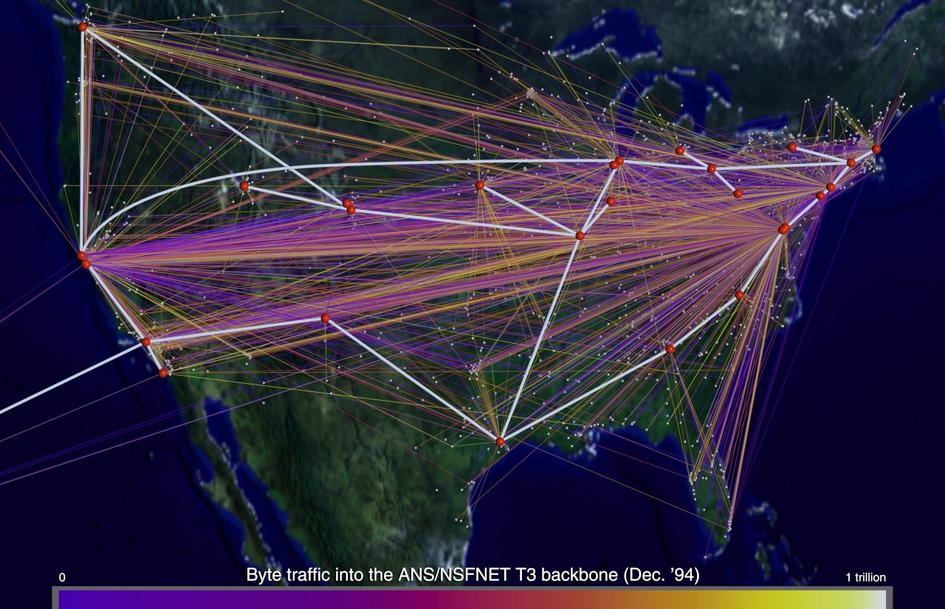
1994: Privatization
NSFNet Topology (National Center for Supercomputing Applications, 1996)
Notes:
NSFNET is the National Science Foundation’s high-speed Internet backbone. In 1992, Congress opened NSFNET up to connect to commercial networks; in 1994, the NSF was ordered to decommission its network and instead lease bandwidth from commercial carriers.
So it’s now 1994. We have a protocol that abstracts away differences between networks. We have a routing scheme that does whatever it takes to get packets delivered, and doesn’t have a controlling authority to bottleneck the creation of new connections. We have a Federal mandate creating a market for the creation of backbone lines. And, thanks to NCSA (the same research institution that created this map here), we have a new server app that presents information in a way even a layman can easily use… but we’ll talk about that next block. Regardless, all the pieces are in place for some really exciting things to start happening. We’re about to go from this…
——————-
Oh, and back in that previous map? Note that the white-hot pipes in this map carried 1 trillion bytes of traffic in December 1994. That sounds like a lot! How long does it take Netflix to use up that much data? 3 minutes. [9 x 10^17 bytes per month; http://www.ciena.com/connect/blog/What-Netflixs-1-billion-video-hours-streamed-means-for-bandwidth.html]

Slide 31
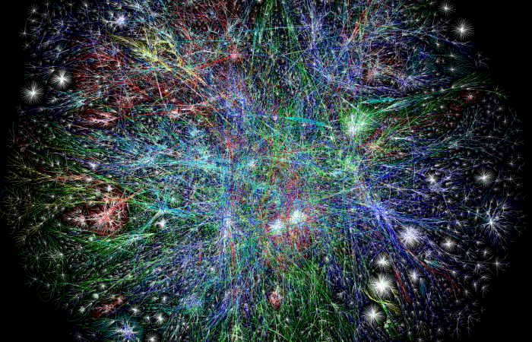
2003: Explosive Growth
Internet Traceroute Map (Barrett Lyon and LyonLabs LLC, 2003)
Notes:
…to this. This map was done in 2003, but even before then, mapping the Internet became effectively impossible. The blue lines here are North Ameria; the green EMEA, yellow Latin America and red Asia.
Oh, and back in that previous map? Note that the white-hot pipes in this map carried 1 trillion bytes of traffic in December 1994. That sounds like a lot! How long does it take Netflix to use up that much data? 3 minutes. [9 x 10^17 bytes per month; http://www.ciena.com/connect/blog/What-Netflixs-1-billion-video-hours-streamed-means-for-bandwidth.html]
[EXERCISE: Let’s run some trace routes.]

Slide 32
The Birth of the Internet
Began as ARPANET, a network of special-purpose computers designed to allow host computers to share resources across the country.
Networking software was moved to the hosts, with a networking protocol (TCP/IP) designed to hide implementation details.
Self-configuring routing system resulted in robust and open network.

